Slide 1
project3_talentberg
To learn ORM (Object Relational Mapping), Table Relationships

Slide 2
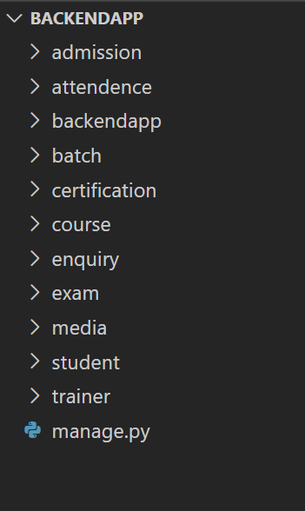
Step1 : Create following applications in Project

Slide 3
Step 2 : Model Classes

Slide 4

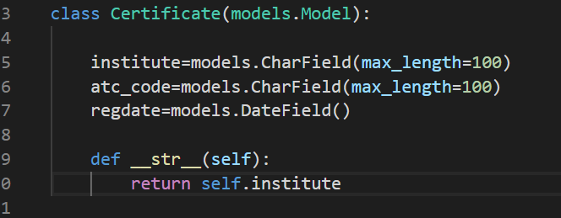
1
2

Slide 5
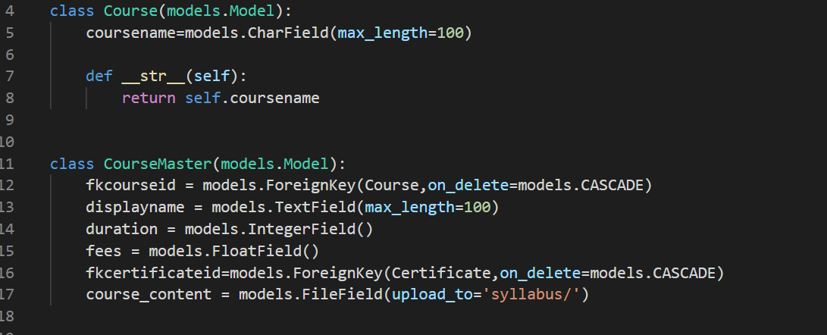
3

Slide 6
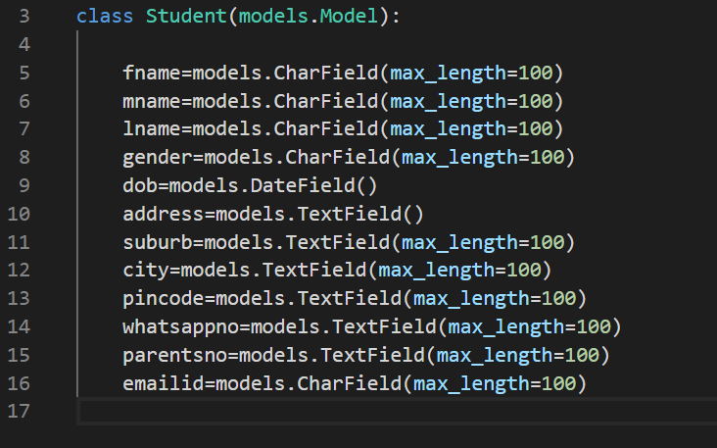
4

Slide 7
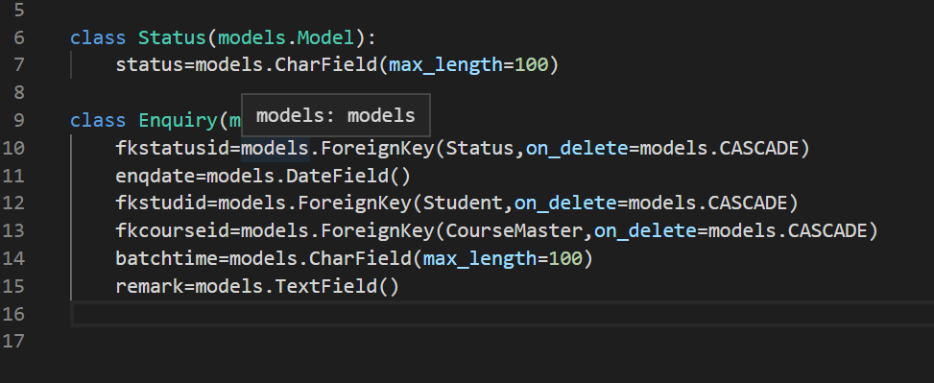
5

Slide 8
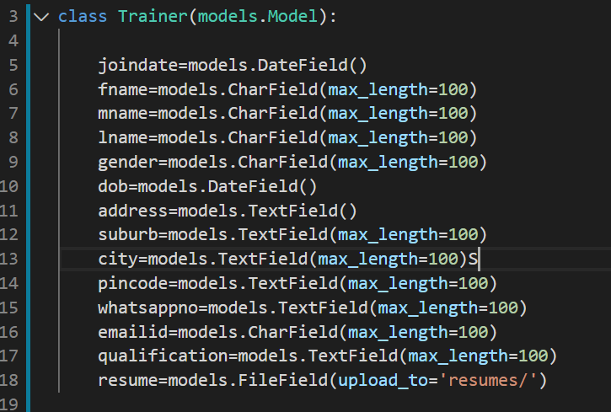
6

Slide 9

7

Slide 10
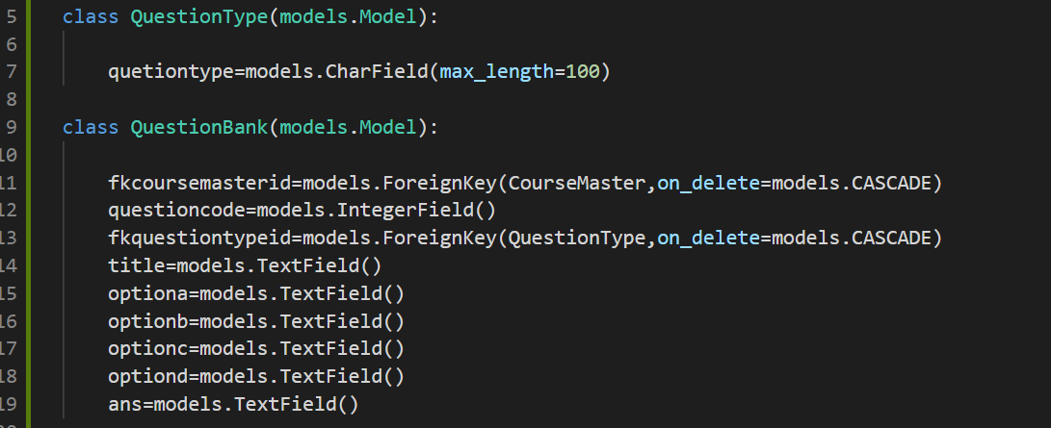
8

Slide 11
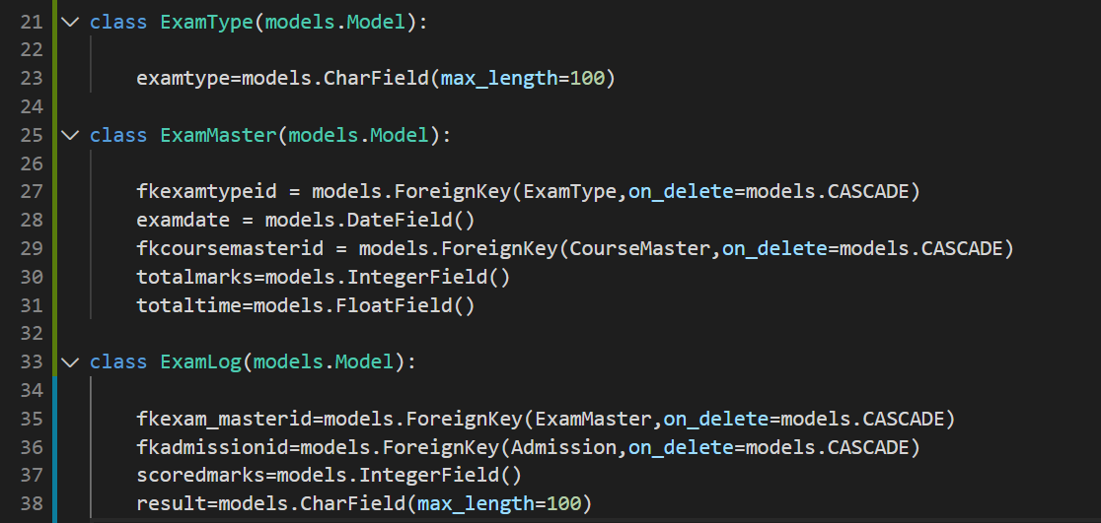
9

